Slide 1
Massachusetts Health Connector:
Open Enrollment and Constituent Services Legislative Briefing
December 2017

Slide 2
Agenda
  Introduction to the Health Connector
  Federal Landscape and Massachusetts
  2018 Open Enrollment for Individuals and Families
  Constituent Services Overview
  Appendix: Constituent Services FAQs

Slide 3
Health Connector 101

Slide 4
Introduction
The Health Connector is the state’s health insurance marketplace, offering Massachusetts residents and small businesses a way to understand their health coverage options, access affordability help, and compare and enroll in quality health and dental plans.
The Health Connector was created by Chapter 58 of the Acts of 2006, a major state health reform aimed at increasing access to health insurance in Massachusetts, and later adapted to incorporate the federal health reforms of the Affordable Care Act (ACA)
    The Health Connector is governed by an eleven member Board of Directors, chaired by Executive Office of Health and Human Services Secretary Sudders (for more information on Board meetings: www.mahealthconnector.org/about/leadership/board-meetings)
    The Health Connector currently serves over 250,000 members
    The Health Connector's programs, outreach and public education efforts, and policies have helped Massachusetts lead the nation with over 97% of residents insured
    In addition to its role as a place to find and compare coverage, the Health Connector plays an active policy role in Massachusetts’ version of health reform, such as determining the policies that govern the Commonwealth’s requirement to have health insurance

Slide 5
Introduction (Cont’d)
    The Health Connector and MassHealth share a common application and eligibility system at www.mahealthconnector.org, but are two distinct agencies, with different staff, call centers, plans, and policies.
    The shared eligibility system allows for fluid movement of individuals between MassHealth and the Health Connector. This is beneficial for members who experience life changes that impact their eligibility
    As a portion of the populations served by MassHealth and the Health Connector are shared between our programs throughout the course of a plan year or within a family, it is not uncommon for both agencies to be involved in a household’s health coverage
*Individuals who are lawfully present and under 133% FPL, but otherwise do not meet Medicaid immigration requirements, may also be eligible for ConnectorCare programs. See chart on slide 34 for details on this and other eligibility requirements.

Slide 6
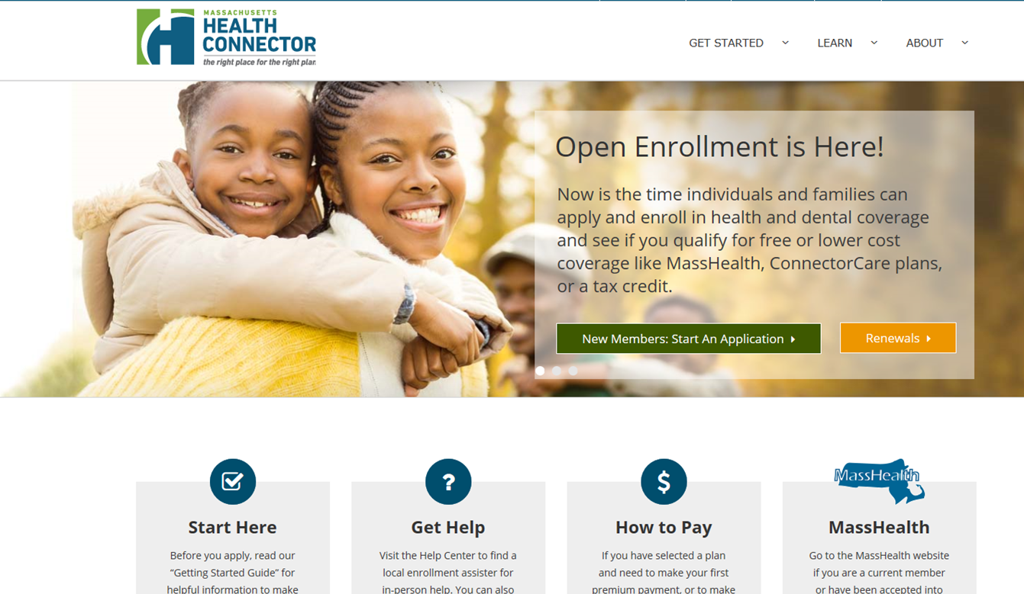
Website for Individuals & Families
  The Health Connector’s website for individuals and families is stable, always improving, and continuing to connect residents to coverage.
Learn more at www.mahealthconnector.org

Slide 7

Website for Small Employer Groups
  In November 2017, the Health Connector launched Health Connector for Business to connect employers with fewer than 50 employees to small group coverage. The new website:
Provides small employers and brokers with a modern, easy-to-use platform and customer service experience
Offers employees of small businesses the ability to shop for savings
Supports a full range of carriers and product options
Includes customer service support that can link employers directly with brokers for local help
Learn more at www.mahealthconnector.org/business

Slide 8


Health & Dental Carriers
Altus Dental
Blue Cross Blue Shield of MA
BMC HealthNet Plan
Delta Dental of MA
Fallon Health
Harvard Pilgrim Health Care
Health New England
Neighborhood Health Plan
Tufts Health Plan – Direct*
Tufts Health Plan – Premier*
*For 2018, Tufts Premier is not available for small groups

Slide 9
Plan Offerings
The Health Connector offers different types of health and dental coverage to meet the needs of different populations of residents and businesses.
Health Connector Plan | Eligible Population
Qualified Health Plan (QHP) | A health plan available through the Health Connector to all: Massachusetts residents that are U.S. citizens, nationals or otherwise lawfully present and are not incarcerated Massachusetts-based employer groups of fewer than 50 employees
Qualified Dental Plan (QDP) | A dental plan available through the Health Connector to all: Massachusetts residents that are U.S. citizens, nationals or otherwise lawfully present and are not incarcerated Massachusetts-based employer groups of fewer than 50 employees
Catastrophic Health Plans | A health plan for adults under 30 or people with an individual mandate hardship exemption. These plans have lower premiums and higher deductibles Covers 3 preventive visits in full without cost-sharing

Slide 10
Affordability Help: Overview
The Health Connector is the exclusive source for residents and employers to connect to subsidies and other savings that can make coverage more affordable.
Individuals & Families
  ConnectorCare: This program provides comprehensive, subsidized (through a mix of state and federal funding) health insurance to low and moderate income individuals and families, i.e., individuals with household income of below 300 percent of the Federal Poverty Level (FPL) (for a household of one, $36,180 annually, or for a household of four, $73,800)
  APTC-Only Plans: Individuals between 300 to 400% FPL may be eligible for a federal-only premium tax credit to reduce the cost of their monthly premiums purchased through the Connector, if they also do not have access to other public health insurance programs (e.g., Medicare, Medicaid) and do not have access to ‘affordable’, comprehensive coverage from their employer.
Small Employer Groups
  Massachusetts’ Wellness Track Program offers up to a 15 percent rebate for premium costs to qualifying employers, if employees participate in certain wellness activities
  Federal tax credits are available to qualifying employers with lower-income employees (typically with an average annual income under $50,000), offering savings of up to 50 percent of an employer’s premium costs

Slide 11
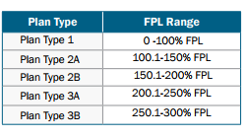
Affordability Help:
ConnectorCare Detail
  The Health Connector’s ConnectorCare program provides comprehensive, affordable health insurance to low-income Massachusetts residents with incomes below 300 percent of the Federal Poverty Level (FPL).
  The ConnectorCare program supplements federal premium tax credits and cost-sharing subsidies with state funds to offer more generous coverage than the federal standard
  ConnectorCare enrollees make small premium payments on a sliding scale, in base amounts ranging from $0 to $126 monthly, depending on income
  ConnectorCare plans have low co-pays, but never include coinsurance or deductibles
  ConnectorCare enrollees can choose from among up to five carriers in 2018, one of which will feature the base premium
ConnectorCare
Sliding-Scale Plan Types
ConnectorCare Base Premiums

Slide 12
Affordability Help:
Small Employer Detail
  Health Connector for Business offers exclusive savings for qualifying small employers that offer group coverage.
Federal Small Business
Health Care Tax Credit
MA Small Group
Wellness Rebate
a
Employer eligibility:
How to claim:
Assistance amount:
Rebate can be up to 15% of employer’s share of group plan premium
Employer eligibility:
Up to 25 FTE (full-time equivalent employees)
Average annual wages must be <$52,000/year/FTE (adjusted for inflation)
Must cover at least 50% of cost of employee-only premiums
Up to 25 employees
Credit can be up to 50% of premiums paid for small business employers
Credit can be up to 35% of premiums paid for small tax-exempt employers
Available for 2 consecutive taxable years
Claim with IRS Form 8941
Purchases through Health Connector
Purchases through Health Connector
How to claim:
Document that 33% of employees meet program’s participation requirements
Assistance amount:
Meets wellness requirements
Must cover at least 50% of the cost of employee-only premiums (and at least 33% if choose to cover dependents)
Sign up when enrolling with the Health Connector
Sliding scale: credit gets bigger if employer is smaller
Available for 3 consecutive plan years

Slide 13
Affordability Help:
Small Employer Detail (Cont’d)
Health Connector for Business is bringing something new to small businesses: a choice of plans for their employees.
Health Connector survey data indicates that 85% of employers would like to offer a choice of plans to their employees, and recent Health Policy Commission and Center for Health Information & Analysis data shows small businesses want to provide plan choice to their employees, but lack an easy mechanism to do so
This data contributed to the development of Health Connector for Business: For the first time, employers can set a monthly contribution level and allow their employees to shop for the plan that best meets their individual needs. Employers never pay more than the contribution level they select
Choice Type | Employer Chooses… | Employee Chooses…
One Plan | One health plan | The one employer-selected health plan
One Carrier | One Carrier (Platinum, Gold, and Silver) | From all health plans offered by the selected carrier across the Platinum, Gold, and Silver metallic tiers
One Level | One Metallic Tier (Gold or Silver) | From all health plans offered by all health insurance companies within the selected metallic tier

Slide 14
Federal Activity and Massachusetts

Slide 15
Potential Impact of Federal Activity
Massachusetts maintains a robust state health reform framework regardless of potential federal changes. However, the Health Connector is closely monitoring federal health reform discussions to gauge impact.
Over the past year, there has been federal dialogue about potential changes to the Affordable Care Act
Massachusetts has maintained the majority of its pre-ACA laws and infrastructure, which could potentially serve our market in the event of federal changes
However, Health Connector enrollees rely on millions of dollars in federal subsidy funds to reduce member costs – some of these subsidies have already undergone changes due to federal action
Despite these and other potential changes, the Health Connector continues to strive to meet Massachusetts’ commitment to coverage and is prepared to weather changes in the federal landscape
.

Slide 16
Federal Administration Activity: Cost-Sharing Reductions
  The federal government recently ceased Cost Sharing Reductions (CSRs) payments to carriers, ending a funding stream that was critical to ensuring affordable health plans for ConnectorCare members.
  Since 2014, the federal government has paid CSRs directly to insurance carriers to offset costs the carriers incur to reduce deductibles, co-pays, and coinsurance for low-income people earning under 250% FPL
  Carriers are obligated to provide CSR-enriched coverage for eligible ConnectorCare members
  On Oct. 12, 2017, the federal government abruptly announced it would no longer make CSR payments to carriers
  Without state action, this would have resulted in an unfunded carrier liability of ~$28M for the remainder of CY17 and ~$146M for CY18

Slide 17
Federal Administration Activity: Cost-Sharing Reductions
  In Massachusetts, CSR subsidies have helped cover the costs of the ConnectorCare program, along with other funding sources:
  Premium costs = Federal premium tax credits + state premium subsidy + enrollee premiums
  Point-of-care costs (i.e. deductible, etc.) = Federal CSRs + state cost-sharing subsidy + enrollee copays

Slide 18
Federal Administration Activity: Cost-Sharing Reductions (Cont’d)
The Health Connector and Division of Insurance have implemented a contingency plan to minimize member exposure and maximize stabilization of the Massachusetts insurance market.
To mitigate immediate harm, the Commonwealth provided limited funds to carriers to offset CSR losses for the remainder of Calendar Year 2017 (CY17)
The CY 2018 contingency plan shifts program costs to mitigate member harm:
  To ensure carriers keep member costs affordable at the point of care, the carriers have been allowed to increase premiums to offset the loss of CSR funds
  These premium increases only affect the plans that previously received CSRs: silver-tier plans offered by ConnectorCare-participating carriers to individuals/families (not small groups)
  As premiums increase, advance premium tax credits (another federal funding stream which is still being paid) also increases – as a result, members who receive these APTCs (under 400% FPL, including Connectorcare members) will be held largely harmless from the increase
However, unsubsidized members (above 400% FPL), could see a significant increase to their premiums for plan year 2018 if they do not shop for a different plan
(See p. 25 for more details on the Health Connector’s efforts to help affected members)

Slide 19
Congressional Activity:
Repeal of Individual Mandate
Congress continues to consider significant changes to the Affordable Care Act, most recently with the repeal of the federal individual mandate.
The Senate recently passed a tax bill that effectively repealed the individual mandate by setting the penalty to zero. The Senate and House versions of the bill will go to conference and likely onward to the President’s signature
    Massachusetts maintains its own individual mandate, which continues to require all adults carry comprehensive coverage that meets standards established by the Commonwealth – largely insulating Massachusetts from the repercussions of federal mandate repeal
    In order to satisfy the individual mandate, adults must enroll in a health plan that meets “Minimum Creditable Coverage” standards – this has helped ensure that Massachusetts meets higher consumer protection standards than other states
    Massachusetts has found that an individual mandate is important to maintaining a stable insurance market, with the right mix of healthier and sicker participants to keep costs affordable: www.mahealthconnector.org/wp-content/uploads/Individual-Mandate-Report-Nov2017.pdf
    The state individual mandate predates the federal mandate and carries its own set of penalties
Congress may continue to consider ACA-related legislation, such as:
    Bills intended to stabilize insurance markets following CSR withdrawal
    Continued attempts at ACA repeal and replace

Slide 20
Federal Rulemaking Activity:
Market Reforms
The Health Connector is closely monitoring potential regulatory changes that could impact the stability of the Massachusetts insurance market.
In mid-October, an Executive Order outlined regulatory priorities:
    Promotion of Association Health Plans
    Promotion of Short-term Limited-Duration Plans
    Promotion of Health Reimbursement Arrangements
Depending on how these policies are implemented, regulations in this area could impact the stability of the merged market for individuals and small businesses
The Health Connector and other agencies will review any regulations closely, which may be forthcoming as soon as mid-December

Slide 21
Open Enrollment 2018 for Individuals & Families

Slide 22
Open Enrollment Overview
Open Enrollment (OE) is the time when individuals are able to enroll in the Health Connector without a Qualifying Life Event (QLE) to trigger a Special Enrollment Period (SEP). OE began on November 1, 2017 and runs through January 23, 2018.
Members could begin shopping for plans with an effective date of January 1, 2018 on November 1, 2017
Members began receiving communications from the Health Connector in September with preliminary eligibility redetermination
    The process of preliminary eligibility identifies and notices a member of their eligibility determination for the upcoming plan year
    If the member disagrees with the determination they are encouraged to submit updates to their information
The Health Connector sent renewal notices to members on behalf of carriers between 10/27 and 11/13
    The new Payment Center allows consumers to view notices sooner
    Members who do not shop and do not experience a change in eligibility will be automatically mapped into their existing plan
    If the same plan is not available, a plan from the same carrier, or within the same metallic tier will be used in mapping

Slide 23
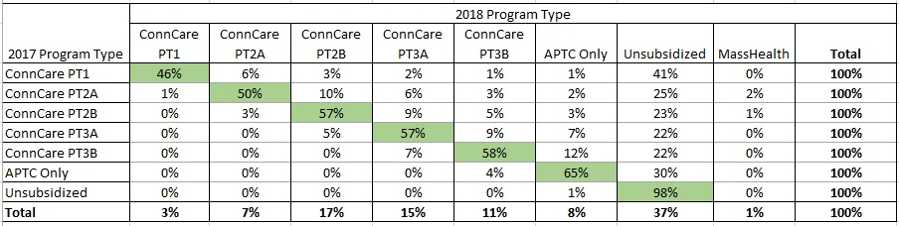
OE Tip: Members Should Update Information to Retain Subsidies
We are projecting substantial member movement based on our preliminary eligibility process, but this could change as members update information. Members should update their information for the best chance at retaining any subsidies for which they may be eligible.
  Overall, approximately 13% of ConnectorCare members are currently slated to move to unsubsidized coverage
    The majority of this movement is attributable to information not being available from state and federal sources (i.e. IRS, DOR, SSA) to confirm member income
    Members who were moved to unsubsidized coverage because we needed updated income information can return to subsidized coverage by submitting their updated income attestation; they may have to send us proof
  The Health Connector is engaged in heavy communications and outreach to encourage members to update their information to ensure accurate eligibility determinations
As of 10/17

Slide 24
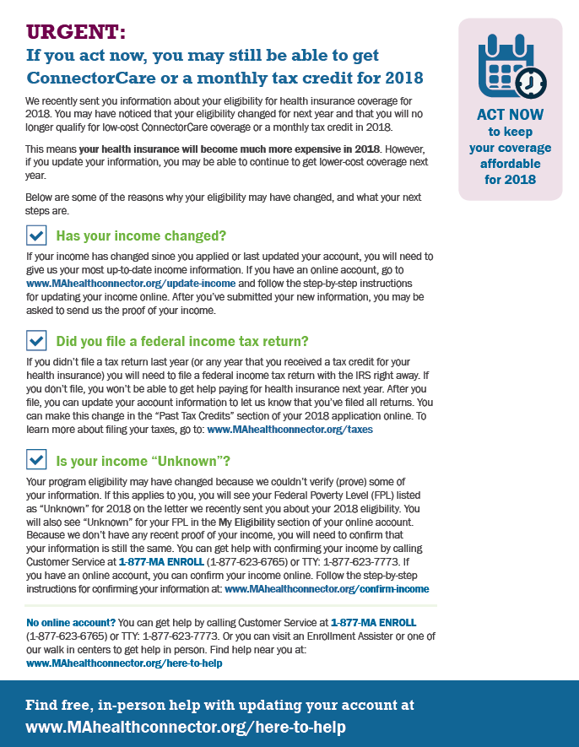
How We’re Helping Members Update Information to Retain Subsidies
Members at risk of losing subsidies have received a special “Lost Subsidies” mailer.
The mailer was sent to members who lost subsidies as part of preliminary eligibility determination
It explains the member’s eligibility change for next year and the types of updates that they might need to make in order to regain eligibility for ConnectorCare or APTCs for 2018

Slide 25
OE Tip: Members Should Shop to Avoid Higher Premiums
This year, certain Health Connector silver plans for individuals will have significant premium increases due to the recent loss of a federal subsidy stream, Cost-sharing Reduction payments (CSRs).
The federal government abruptly announced that they would immediately terminate CSR payments to health insurance carriers, though carriers are obligated to provide CSR-enriched coverage for eligible ConnectorCare members
To address this issue, certain Health Connector carriers needed to significantly increase premiums for their silver-tier plans to account for the lost funding
  For subsidized members such as ConnectorCare and APTC-only members, the higher premiums also trigger higher advance premium tax credits, which largely offset the impacts of the higher rates
  However, unsubsidized silver tier members will experience higher rates because they will not have offsetting subsidies. Up to 80,000 silver tier members could have been impacted by premium increases of 26% on average.
    This number has decreased, as of November 30th ~14,000 members have taken action

Slide 26
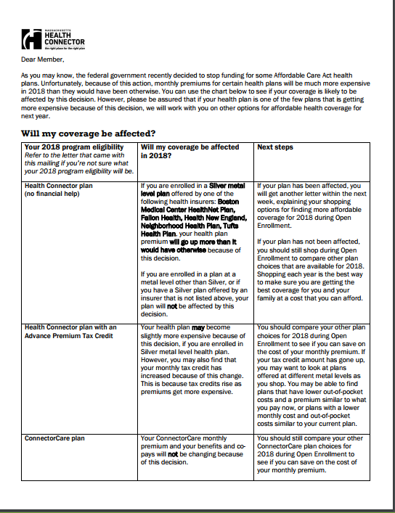
How We’re Helping Members to Shop to Avoid Higher Premiums
  The Health Connector is encouraging members in the impacted unsubsidized silver tier plans to update their information, consider other options and shop during Open Enrollment to find a plan that meets their needs:
  Members can consider gold or bronze plans through the Health Connector, since plans on other metallic tiers are unaffected by the higher rates
  Members that prefer the benefits offered on the silver tier can consider buying a plan directly through an insurance carrier. Buying an individual/family insurance plan directly from an insurance carrier is known as buying “Off-Exchange.”
  In the November, December and January bills, members will get additional inserts promoting shopping

Slide 27
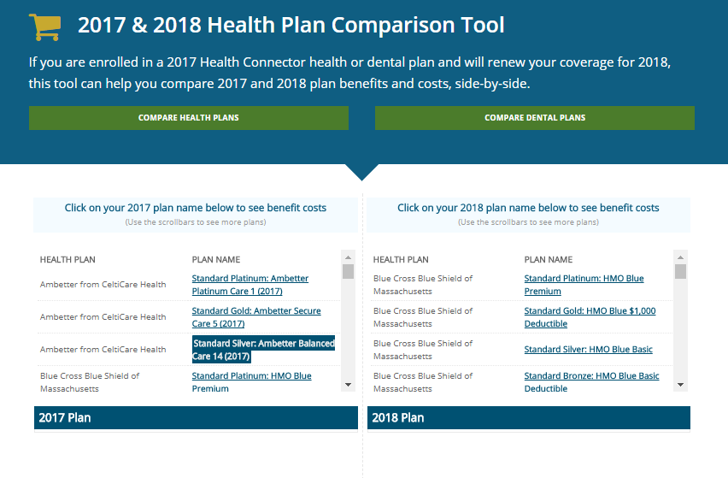
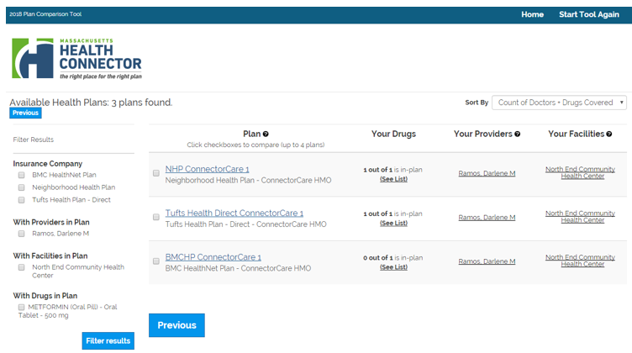
Member Help: Online Shopping Tools
The Health Connector continues to make online decision support tools available to members to help them select the right plans. New this year, the Health Connector is testing a formulary search tool for prescription drugs.
Find our 2017 to 2018 Plan Comparison tool at: www.mahealthconnector.org/compare-plans
Find our provider & formulary search tool at: https://ma.checkbookhealth.org/hie/ma/2018/
Find other helpful resources, like our Shopping Guide, at: www.mahealthconnector.org/help-center/resource-download-center

Slide 28
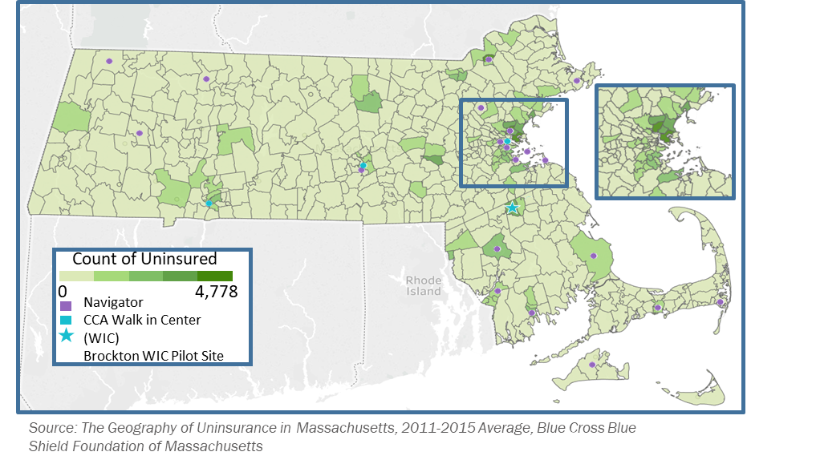
Member Help: Call Center & Walk-In Centers
Open Enrollment 2018 Call Center Hours of Operation | Closed Enrollment Call Center Hours of Operation
Monday – Thursday 8AM - 8PM | Monday – Thursday 8AM – 6PM
Friday 8AM – 6PM | Friday 8AM – 6PM
Saturday 9AM – 5PM | Saturday CLOSED
1-877-623-6765 (MAENROLL)
2018 Open Enrollment Call Center Hours remain consistent with hours of operation during Open Enrollment 2017
  Monday – Thursday: 8AM - 8PM
  Friday: 8AM - 6PM
  Saturday: 9AM – 5PM
  Sunday: Closed
Walk in Centers in Boston, Springfield, Worcester and Brockton remain open year round to assist new and renewing members. Find locations at: www.mahealthconnector.org/about/contact.

Slide 29
Member Help: Navigator Network
The Health Connector maintains a state-wide network of Navigators and other in-person consumer assisters. Our Navigator Program continues to be fully supported and is not affected by federal funding shortfalls. Find local help at https://betterhealthconnector.com/enrollment-assisters.

Slide 30
Member Activity: Open Enrollment
With a stable system and user process complemented by a proactive outreach and education effort, the Massachusetts Health Connector has seen members and new applicants more active in the first month of Open Enrollment compared to last year.
Since Open Enrollment began on November 1, 15,000 new applications have been submitted
As of Nov. 15, plans selected and enrollments are more than 40 percent higher than last year at the same time
Call center activity is higher than last year with more members seeking assistance and noting that Health Connector Outreach and Communications had motivated them to call

Slide 31
Appendix: Constituent Services
Frequently Asked Questions

Slide 32
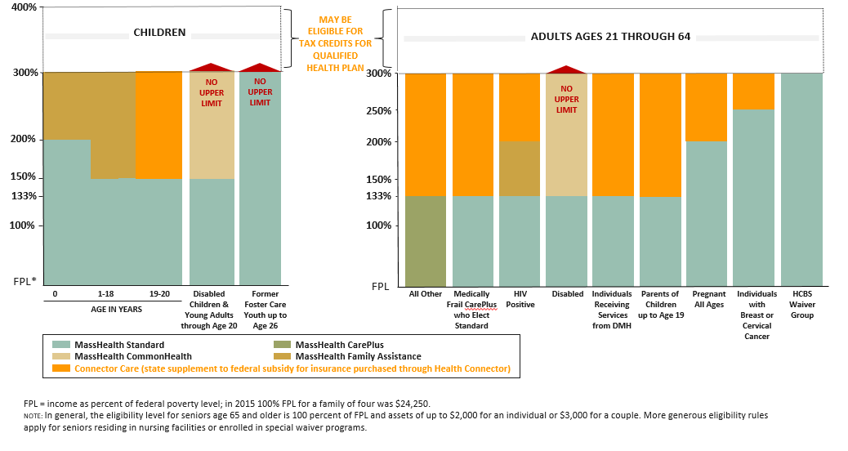
What Is My Constituent’s Eligibility?
MassHealth and the Health Connector share an application and eligibility system, streamlining the application process. If a member is not eligible for MassHealth, they may be found eligible for a QHP through the Health Connector without having to submit an additional application.
ABOVE 400% FPL ELIGIBLE FOR UNSUBSIDIZED QUALIFIED HEALTH PLAN
Graphic courtesy of the Blue Cross Blue Shield Foundation of Massachusetts, June 2016, available here:
https://bluecrossmafoundation.org/publication/updated-masshealth-basics-june-2016

Slide 33
Why Isn’t My Constituent Eligible?
For an applicant to be eligible for a individual/family Qualified Health Plan (QHP) through the Health Connector they must:
Eligibility Criteria | Definition/Notes
Be a resident of Massachusetts | Resident is defined as having an intent to reside in Massachusetts, or someone who is the dependent of a tax filer who intends to reside in Massachusetts
Be lawfully present in the US | Lawfully present individuals are citizens and non-citizens with valid immigration statuses during the benefit year
Not be incarcerated | Incarceration is defined as someone in jail or prison, unless they are pending the disposition of charges (pre-trial)
For an applicant to be eligible to receive subsidies through the Health Connector they must also be:
Eligibility Criteria | Definition/Notes
Not eligible for public Minimum Essential Coverage (MEC) | Public MEC includes: Eligibility for Medicaid, Medicare, Peace Corps and TRICARE Enrollment in VA coverage or individual market coverage
Not eligible for affordable, minimum value Employer-Sponsored Insurance (ESI) | ESI meets both minimum value and affordability standards if: The plan has an actuarial value of at least 60% Self-only coverage costs less than 9.56% of household income in 2018
Income under 400% FPL (APTC only) or under 300% (ConnectorCare) | Modified Adjusted Gross Income (MAGI) for the tax household is less than the federal poverty standard for the household’s size
American Indian or Alaska Native | Indian is defined in Section 4(d) of the Indian Self-Determination and Education Assistance Act.
In conjunction with our Ombudsman team Health Connector staff work with Congressional and Legislative offices to resolve constituent inquires relative to previous, current and future enrollments in the Health Connector.
Open Enrollment 2018
  The period in the year when you can enroll or change plans in a health insurance plan through the Health Connector Marketplace without a qualifying event
  Open Enrollment for 2018 runs from November 1, 2017 to January 23, 2018
*this includes Medicare, Medicaid and tri-care
Not be eligible for public Minimum Essential Coverage (MEC)*
Not be eligible for affordable minimum value Employer – Sponsored Insurance (ESI)
Have income under 400% FPL (APTC only) or under 300% (Connector Care)
Eligibility Criteria for a Qualified Health Plan
Be a resident of Massachusetts
Be lawfully present in the US
Not be incarcerated
Health Connector Coverage for new applicants always prospective
Applicants must apply, select a plan and make their first payment by the 23rd day of the month prior to when they want their coverage to begin
Be a resident of Massachusetts
Be lawfully present in the US
Not be incarcerated

Slide 34
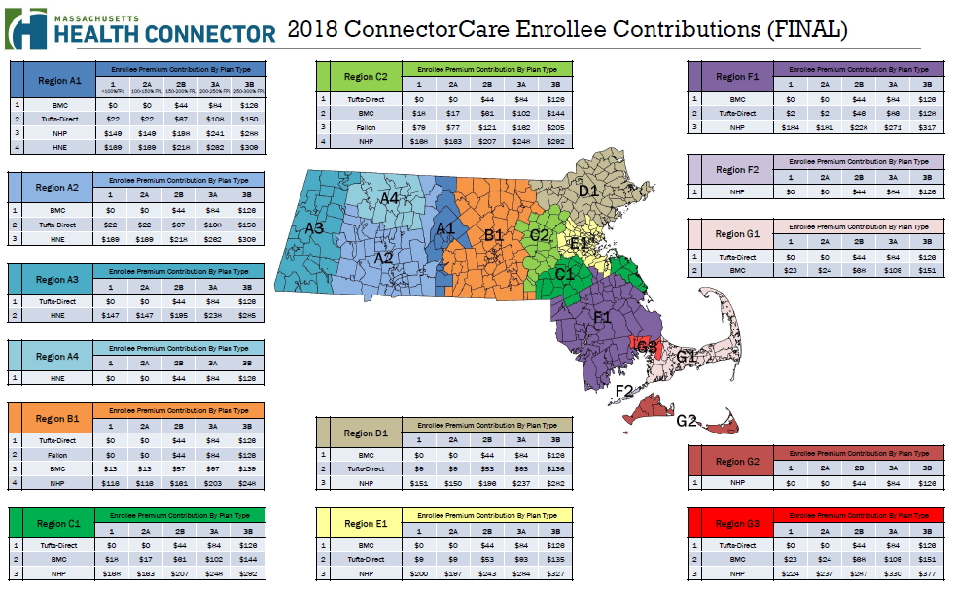
What Can My Constituent Expect to Pay in the ConnectorCare Program?

Slide 35
When Can My Constituent Enroll?
An applicant can submit an application for coverage at anytime during the year, however, if it is outside of the Open Enrollment period an applicant must have experienced a Qualifying Life Event (QLE) and enroll through a Special Enrollment Period (SEP).
Generally, a QLE must be reported within 60 days, once reported a SEP will be open for a limited time, authorizing a member to enroll
Open Enrollment runs from November 1, 2017 through January 23, 2018
  New and returning members do not require a QLE during this time to shop for a plan
  For coverage effective January 1, 2018 plan selection and payment must be made prior to 12/23
  For coverage effective February 1, 2018 plan selection and payment must be made by 1/23
Health Connector* Qualifying Life Events include: (see for detail: https://betterhealthconnector.com/get-started/special-enrollment-period)
Marriage Birth or adoption of a child Change in residency (such as moving to MA) Loss of MEC Newly eligible for ConnectorCare or APTC or certain changes to subsidy eligibility *Note that individuals eligible for MassHealth can apply year-round | New lawfully present immigration status Certain other circumstances such as Victims of Domestic Violence American Indian or Alaska Native Waiver through Office of Patient Protection

Slide 36
When Can My Constituent Start or Cancel Coverage?
Health Connector coverage for new applicants is prospective, which means applicants must select a plan and make their first payment by the 23rd day of the month prior to when they want coverage to begin
In rare circumstances, existing members may be eligible for reinstatement or retroactive-enrollment into an existing plan
  Member is required to pay for the months that they are requesting reinstatement into and one future month to avoid immediate loss of coverage in next month
  Reinstatements and Retro-active enrollments are subject to carrier approval and must be requested within allotted timeframes
A member must cancel coverage by the 23rd of the month prior to the first of the month that they want to stop receiving coverage

Slide 37
Why Is My Constituent Receiving or Being Asking for Information?
Requests for Information
  Upon submitting or reporting a change to an application a member may be requested to submit verification for items such as income, residency, citizenship, etc. within an expressed timeframe in order to ensure continued coverage
  If these documents are not submitted within the adequate timeframe a member is subject to eligibility changes or termination of coverage
    Denial Notices
  Because of the shared application and eligibility system, if an individual is found eligible for a Qualified Health Plan (QHP) through the Health Connector, the individual will receive a denial notice from MassHealth, even if the constituent did not intend to apply for MassHealth

Slide 38
Why Did My Constituent Lose Subsidies?
Members may contact your office if they are found ineligible for subsidies, this can occur for a number of reasons and in some cases we are not allowed to tell you the reason because of privacy laws
Our Ombudsman team works with members to identify what factors may be barring them from accessing subsidies and reviews the following checklist with them in an effort to determine the root cause, such as:
  Income level
  Access to Employer Sponsored Insurance (ESI) that meets affordability and value standards
  Access to government minimum essential coverage (Tricare, Medicaid, Medicare, VA)
  Invalid tax-filing status (such as “married filing separately” status)
  Failure to file and reconcile taxes, including the IRS’ Form 8962 - due to federal tax privacy laws, it may be difficult for us to communicate that this is the reason a person is being denied subsidies

