Slide 1
Capital Programming Committee South Coast Rail Phase 1 Service
Project Briefing
February 6, 2018

Slide 2
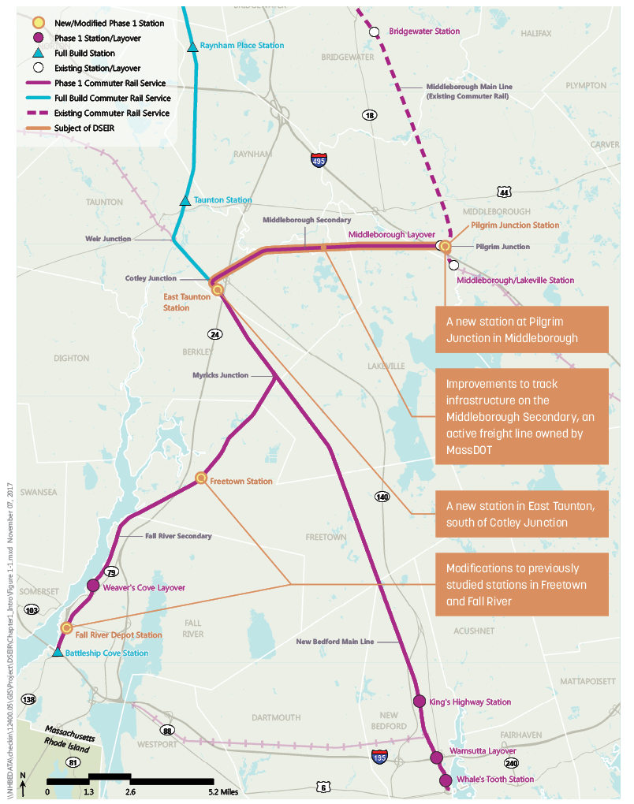
The Phased Approach
MIDDLEBOROUGH-Phase 1
Construct the Southern Triangle (Cotley South to New Bedford and Fall River)
Upgrade the Middleborough Secondary (currently used by freight trains)
New station in Middleborough
Extend Middleborough/Lakeville diesel service to New Bedford and Fall River
Anticipated service to start in Late 2022
STOUGHTON ELECTRIC-Full Build
Advancing preliminary design
Notes:
How about new station in East Taunton; how about – begin Phase 1 Service in 2022? Put date for Stoughton Electric in comparison

Slide 3
Why is MassDOT Proposing to Build Phase 1 Now?
Provides commuter rail to the region in 2022
One-seat ride from New Bedford and Fall River to Boston
Cost of the Stoughton Full Build has increased to $3.2B while design and construction timeline lengthened
No wetland variances required for Phase 1
Notes:
How about new station in East Taunton; how about – begin Phase 1 Service in 2022? Put date for Stoughton Electric in comparison

Slide 4
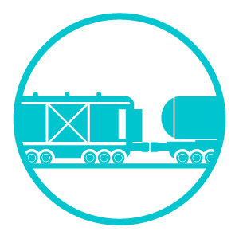
What are the Benefits of Phase 1 Construction?
Provides earlier service for the South Coast region
Catalyzes air quality, economic and smart growth benefits much sooner as detailed in the DSEIR
Uses active rail lines owned by MassDOT
Phase 1 will build 56% of the rail miles needed for the Full Build
Avoids major wetlands impacts
Foundation for Stoughton Electric Service and provides service while Full Build complexities are addressed
Notes:
Or put dates here

Slide 5
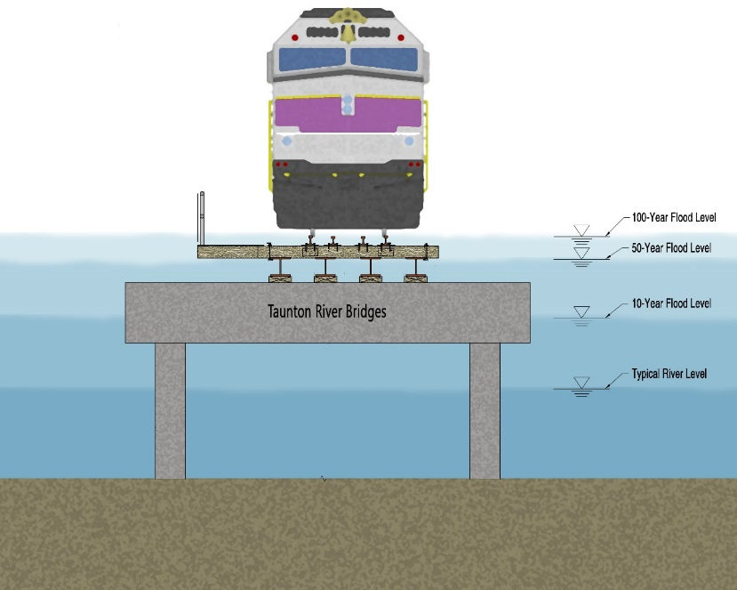
What are the Benefits of Construction Phase 1?
Safety upgrades include PTC, signal and grade crossing improvements
Accomplishes MassDOT/MBTA goals for State of Good Repair
Upgrades to be used by existing freight services
Provides resiliency for Taunton River Bridges during 100-year storms for Full Build
New station in Middleborough provides opportunity for year-round Cape Service

Slide 6
How Did MassDOT Arrive at the Phase 1 Alternative?
Through a thorough analysis detailed in the DSEIR Ch.2, MassDOT screened seven service alternatives on the following factors:
One-seat ride from New Bedford/Fall River to Boston
Minimal environmental impacts
Efficient train operations
Stage for future Cape Service
Passenger service in 2022

Slide 7
What Elements are Included in Phase 1?
Extend existing Middleborough/Lakeville service using diesel-powered trains to New Bedford and Fall River
Reconstruct 17.3 miles of New Bedford Main Line and 11.7 miles of Fall River Secondary (common to both Phase 1 and Full Build
Upgrade existing Middleborough Secondary track from Pilgrim Jct to Cotley Junction (7.1 miles)
Construct 2 new layover facilities
Construct 6 new stations
Notes:
Move to the end

Slide 8
Phase 1 DSEIR Elements Not Previously Studied
New station at Pilgrim Junction
Improvements to track infrastructure on Middleborough Secondary
New station in East Taunton, South of Cotley Junction
Station modifications to previously studied stations in Freetown and Fall River
Notes:
Move to the end

Slide 9
How Often Will the Trains Operate?
13 round trips per day to the South Coast (26 total trips)
3 peak period trips to/from the terminal stations of Fall River and New Bedford
3 to 4 off-peak period trains to Fall River and New Bedford
Notes:
Move to the end

Slide 10
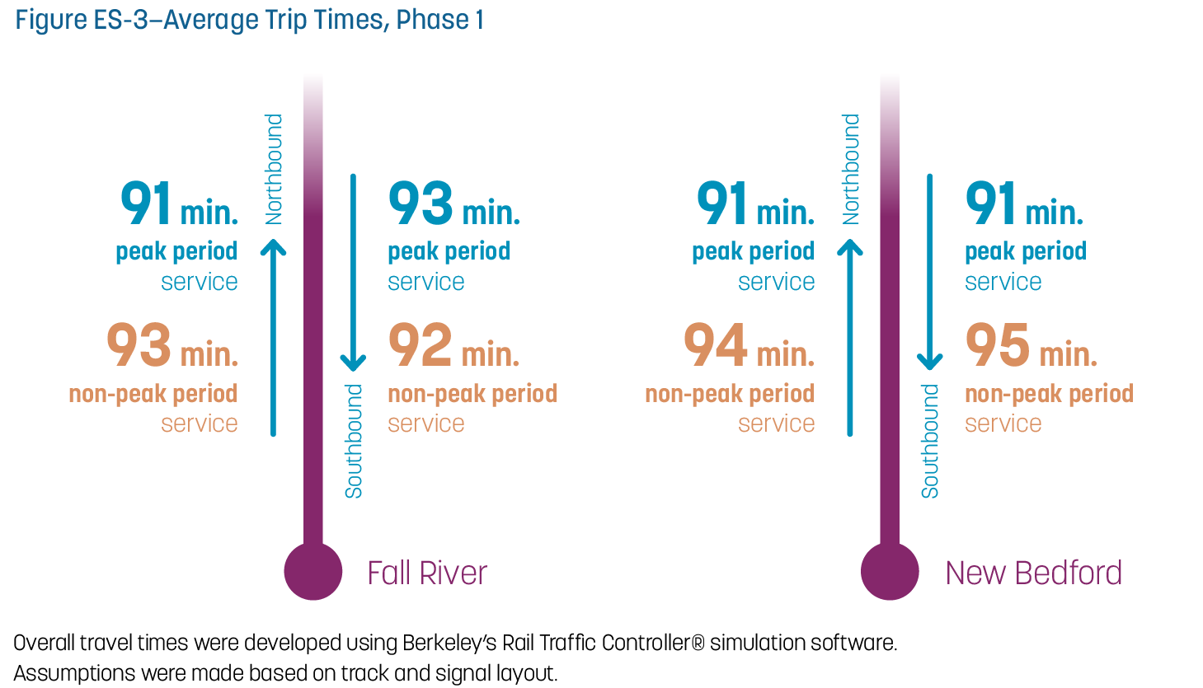
What are the Average Trip Times?

Slide 12
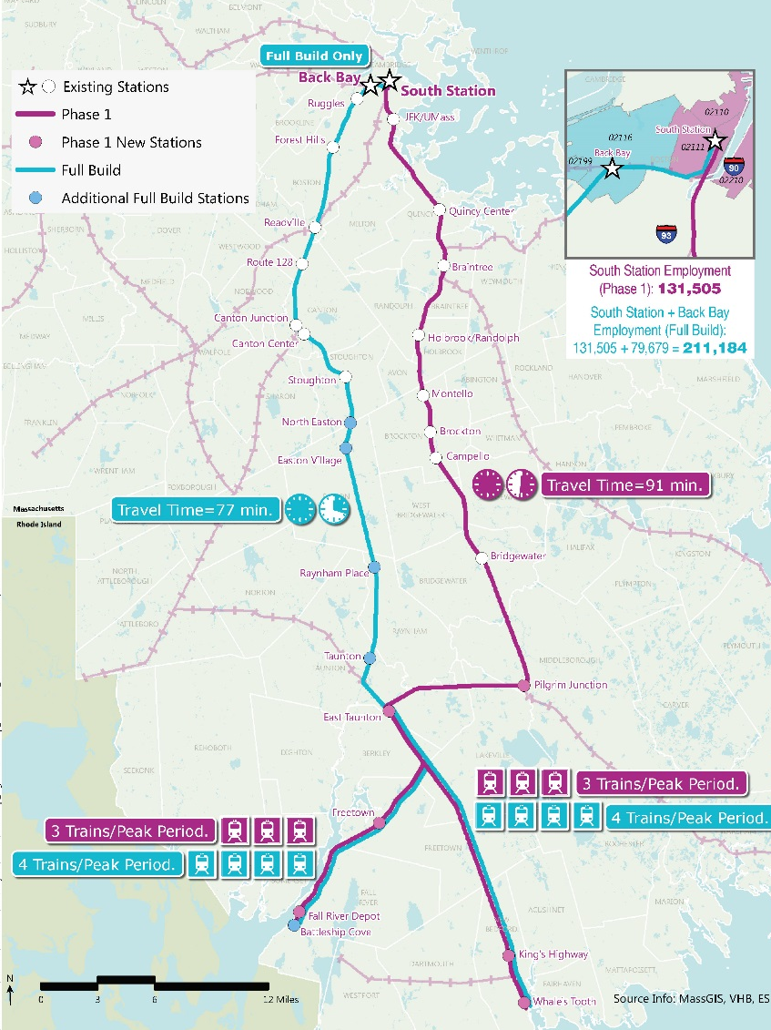
Ridership Projections
 | Full Build 2035 (2011 CTPS Analysis for FEIS/FEIR) | Full Build 2040 (2017 CTPS Analysis) | Phase 1 2030 (2017 CTPS Analysis)
Boardings at New Stations* | 4,570 | 3,960 | 1,610
* Boardings at new stations are a combination of both new riders and those diverted from existing MBTA commuter rail stations.
Changes from 2011 to 2017 Analysis included:
Updated CTPS baseline commuter rail counts to reflect current use of MBTA system
Population growth changes (previously 17 percent for the region, now 6-7 percent)

Slide 13
Ridership Details
Inbound Boardings | Full Build – 2035 (2011 CTPS Analysis) | Full Build – 2040 (2017 CTPS Analysis) | Phase 1 – 2030 (2017 CTPS Analysis)
North Easton | 460 | 370 | -
Easton Village | 150 | 140 | -
Raynham | 430 | 250 | -
Taunton | 670 | 710 | -
East Taunton | 400 | 350 | 420
Freetown | 180 | 140 | 60
Fall River Depot | 840 | 550 | 390*
Battleship Cove | 240 | 250 | -
King’s Highway | 520 | 410 | 260
Whale’s Tooth | 680 | 790 | 480
*Fall River Depot is projected to have less than 60% of riders park at the station.

Slide 14
Ridership for Phase 1
Daily one-way trips – 3,220
One-way trips per year – 837,200
Ridership at new stations in Phase 1 will be 41% of Full Build ridership for 1/3 the cost.
Reduction in Vehicle Miles Traveled – 66,400
One-way trips before Full Build completed – about 7 million

Slide 15
How Were the Number of Riders Estimated?
CTPS performed ridership analysis using the FTA approved ridership model
Ridership model was refined specifically for the South Coast study area using MPO travel model and statewide model
Notes:
Move to the end

Slide 16
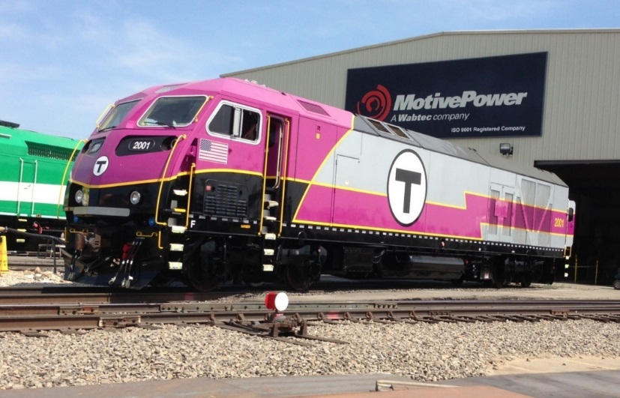
Air Quality
Notes:
This seems a bit lost – and I don’t think the proposal says we are using diesel for Phase 1?

Slide 17
Environmental Justice
Phase 1 serves 72% of the EJ population served by Full Build
Train service is important to this region because
21% of Fall River residents do not have cars
22% of New Bedford residents do not have cars
EJ Population within 1/2 mile of stations:
86% of population served by New Bedford Whale’s Tooth station is EJ
>50% of population served by Fall River Depot is EJ

Slide 18
What will MassDOT do to Mitigate Impacts?
Traffic intersection upgrades, modifications
At-grade crossing improvements
Increase resiliency and climate adaptation through design
Wetland mitigation
Comply with water quality standards
Noise mitigation
Technical assistance grants to municipalities
Notes:
Move to the end

Slide 19
How will MassDOT Help Communities Plan?
Technical Assistance previously completed
More than 125 projects
Projects involving over twenty (20) communities
Coordinated with the local regional planning agencies
Studies included supporting:
Updated zoning maps
Transit Oriented Development concepts at proposed stations
New sections of the Smart Growth /Smart Energy Toolkit
Bike/Ped path projects
Housing production plans
$200,000/year for design in the next several years
Notes:
Move to the end

Slide 20
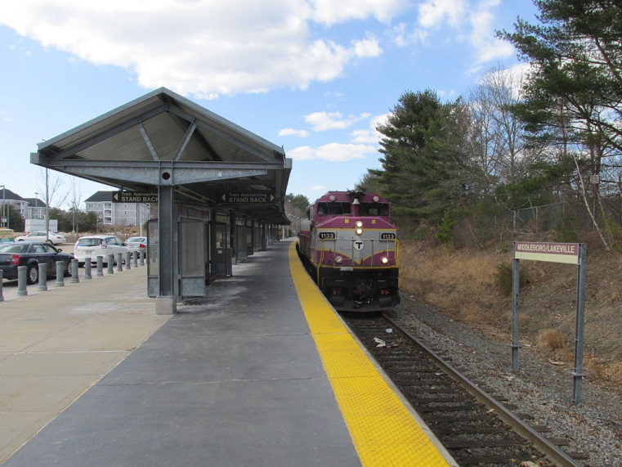
How Much will Phase 1 Cost?
Capital Cost – Phase 1: $935M (service in late 2022)
85% of cost is for the Southern Triangle
More than $800M will go toward $3.2B Full Build
Escalation savings offset cost for Middleborough Secondary improvements
Saves $153M in escalation costs by building Southern Triangle sooner
Capital Cost – Full Build: $3.2B (service no sooner than 2030)

Slide 21
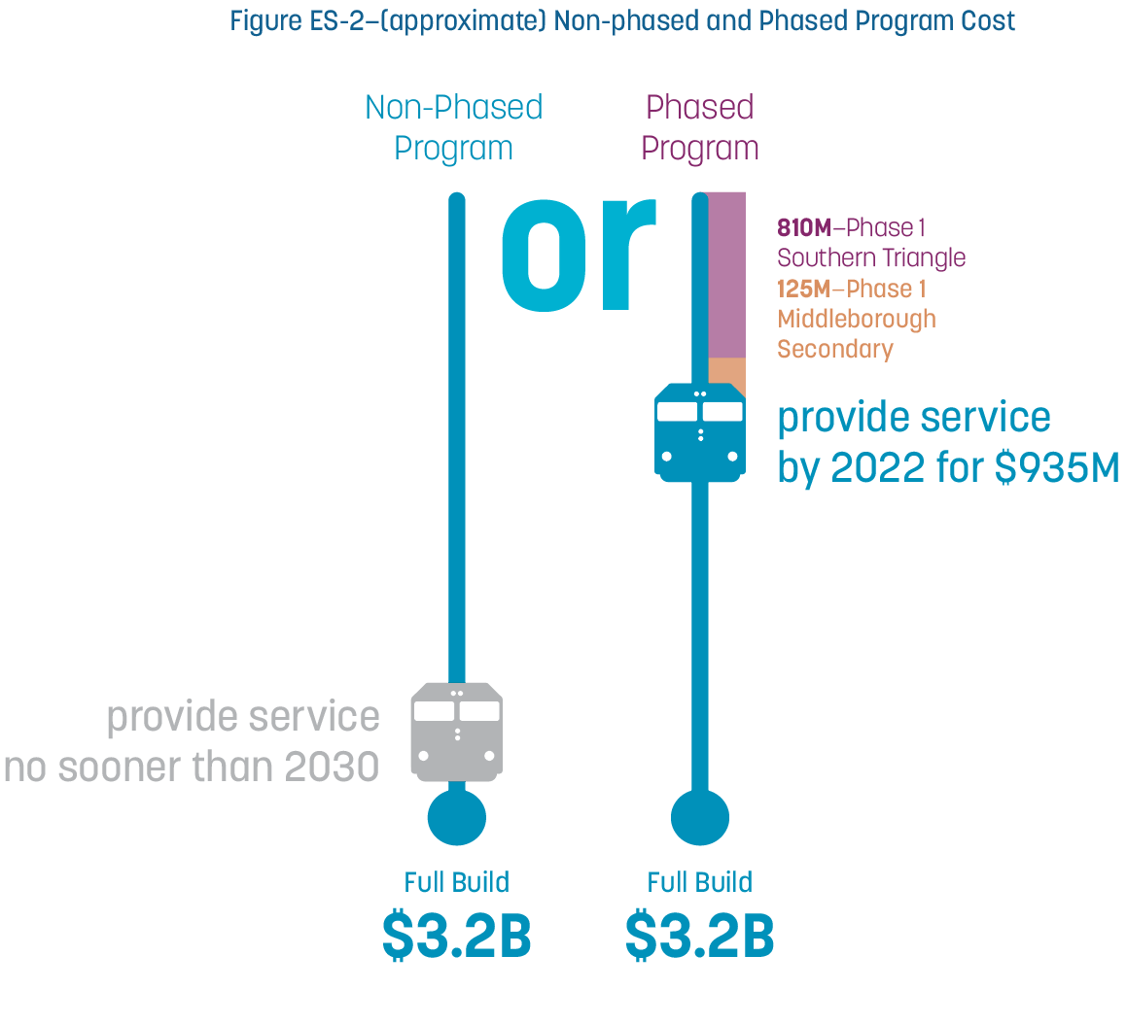
Non-Phased and Phased Program Costs
Same cost for earlier start of service

Slide 22
Phase 1 Schedule
Element |  |  |  | CY2017 |  |  |  | CY2018 |  |  |  | CY2019 |  |  |  | CY2020 |  |  |  | CY2021 |  |  |  | CY2022
 |  |  |  | Q1 | Q2 | Q3 | Q4 | Q1 | Q2 | Q3 | Q4 | Q1 | Q2 | Q3 | Q4 | Q1 | Q2 | Q3 | Q4 | Q1 | Q2 | Q3 | Q4 | Q1 | Q2 | Q3 | Q4
Middleborough Secondary Conceptual Development
Preliminary & Final Design
Environmental Permitting
DSEIR & FSEIR
Land Acquisition Process (Stations & Layovers)
Early Action Construction
Material Procurement
Phase 1 Construction/Commissioning
Notes:
Is this final? Move to the end

